Slide 1

Unity 3D Essentials
Collisions & Physics
SoftUni Team
Technical trainers
Software University
https://softuni.org

Slide 2

Table of Contents
Collider types, Collision types & Detection types
Physics Manager, Physics Materials, Raycast
Rigidbody, Rigidbody scripting & Joints
Useful links

Slide 3
Have a Question?
sli.do
#Unity3D-Basics
Notes:
‹#›

Slide 4

Collider types, Collision types & Detection types

Slide 5
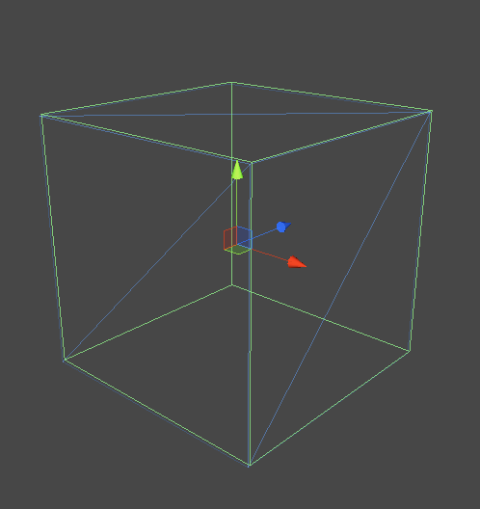
Collider Types
Common Collider Types
Box
Sphere
Capsule
Mesh

Slide 6
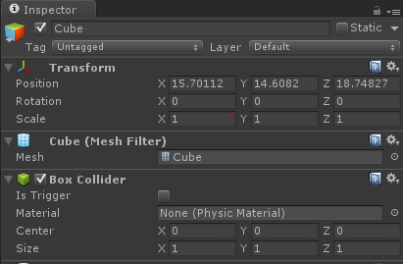
Collisions
Collisions
Is Trigger
Material
Center, Size
Rigidbody

Slide 7
Detection
IsTrigger -> False
void OnCollisionEnter(Collision collision)
void OnCollisionExit(Collision collision)
void OnCollisionStay(Collision collision)
IsTrigger -> True
void OnTriggerEnter(Collider collider)
void OnTriggerExit(Collider collider)
void OnTriggerStay(Collider collider)

Slide 8

Physics Manager, Materials, Raycast & Joints

Slide 9
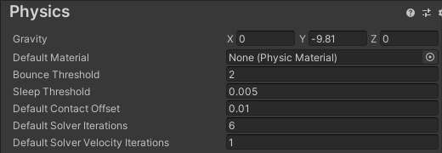
Physics Manager
Gravity Vector
Default Material
Bounce Threshold
Sleep Threshold
Solver Iteration
Layer Matrix

Slide 10
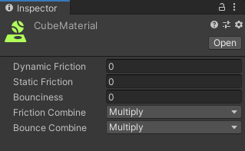
Physic Materials
Dynamic Friction
Static Friction
Bounciness
Friction Combine
Bounce Combine

Slide 11
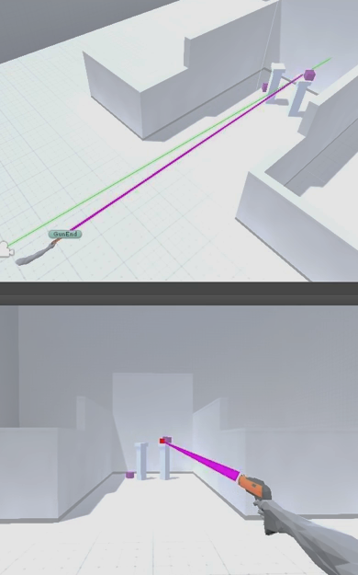
Raycast
Origin
Direction
Max Distance
Layer Mask
Hit Trigger?
RaycastHit hit;
if(Physics.Raycast(transform.position, transform.forward, out hit, 20f))
{
Debug.Log("hit : " + hit.collider.name);
}

Slide 12
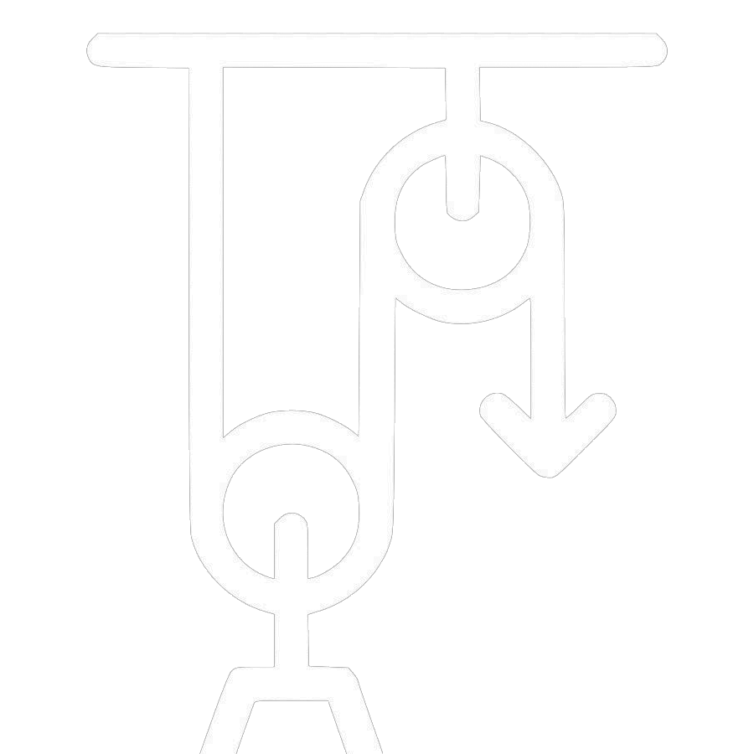
Rigidbody, RB scripting & Joints

Slide 13
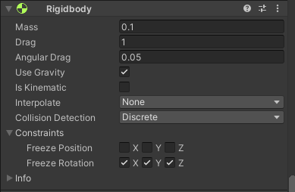
Rigidbody
Mass
Drag
Angular Drag
IsKinematic
Use Gravity
Interpolate
Collision Detection
Constrains
Freeze Position
Freeze Rotation

Slide 14
Rigidbody scripting
Basic methods & properties
public class RigidBodyExample : MonoBehaviour
{
public float thrust = 1.0f;
public Rigidbody rb;
void Start()
{
rb = GetComponent<Rigidbody>();
rb.AddForce(transform.forward * thrust); }
Debug.Log(rb.Velocity)
rb.MovePosition/Rotation(Vector3);
}

Slide 15
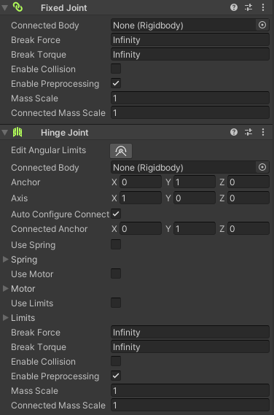
Joints
What is Joint?
Joint types
Fixed
Spring
Hinge
Character
Configurable

Slide 16
Useful Links
http://unity3d.com/learn/tutorials/modules/beginner/physics
http://docs.unity3d.com/Manual/class-PhysicsManager.html
http://docs.unity3d.com/ScriptReference/Collision.html
http://docs.unity3d.com/Manual/class-Rigidbody.html
https://youtu.be/f4xikqJdkwM

Slide 17

Summary
Collider types, Collision types & Detection types
Physics Manager, Materials, Raycast
Rigidbody, Rigidbody scripting & Joints
Useful links
Notes:
‹#›

Slide 18
Questions?
Email : dstrashilov@gmail.com
Notes:
‹#›

Slide 19

License
This course (slides, examples, demos, exercises, homework, documents, videos and other assets) is copyrighted content
Unauthorized copy, reproduction or use is illegal
© SoftUni – https://about.softuni.bg
© Software University – https://softuni.bg
Notes:
‹#›

Slide 20
Trainings @ Software University (SoftUni)
Software University – High-Quality Education, Profession and Job for Software Developers
about.softuni.bg, softuni.org
Software University Foundation
softuni.foundation
Software University @ Facebook
facebook.com/SoftwareUniversity
Software University Forums
forum.softuni.bg
Notes:
‹#›

